Slide 1

DriverPass System Analysis
Ruben Rodriguez

Slide 2

System Requirements
Functional Requirements:
Students can schedule and manage driving lessons
Users can register, buy packages, and take practice tests
Nonfunctional Requirements:
Works on phones, tablets, and computers
Keeps user information private and secure
Notes:
For the DriverPass system, we identified two types of requirements: functional and nonfunctional.
Functional requirements describe the core services the system must provide to users. First, students need to be able to schedule and manage their driving lessons directly through the platform. This makes the process more flexible and convenient for both students and instructors. Second, users must be able to register for an account, choose and purchase a learning package, and take practice tests online. These features help students manage their progress and prepare for their licensing exams.
Nonfunctional requirements describe how the system should perform. One major goal is accessibility, the platform should work on any device, whether it’s a computer, tablet, or smartphone. This ensures that users can interact with DriverPass anytime and anywhere. Another key nonfunctional need is privacy and security. Since we’re handling personal data like names, contact info, and appointment schedules, the system must protect that information through secure logins and data encryption.
Together, these requirements ensure DriverPass meets the needs of students and staff by providing a reliable, easy-to-use, and secure learning platform.

Slide 3
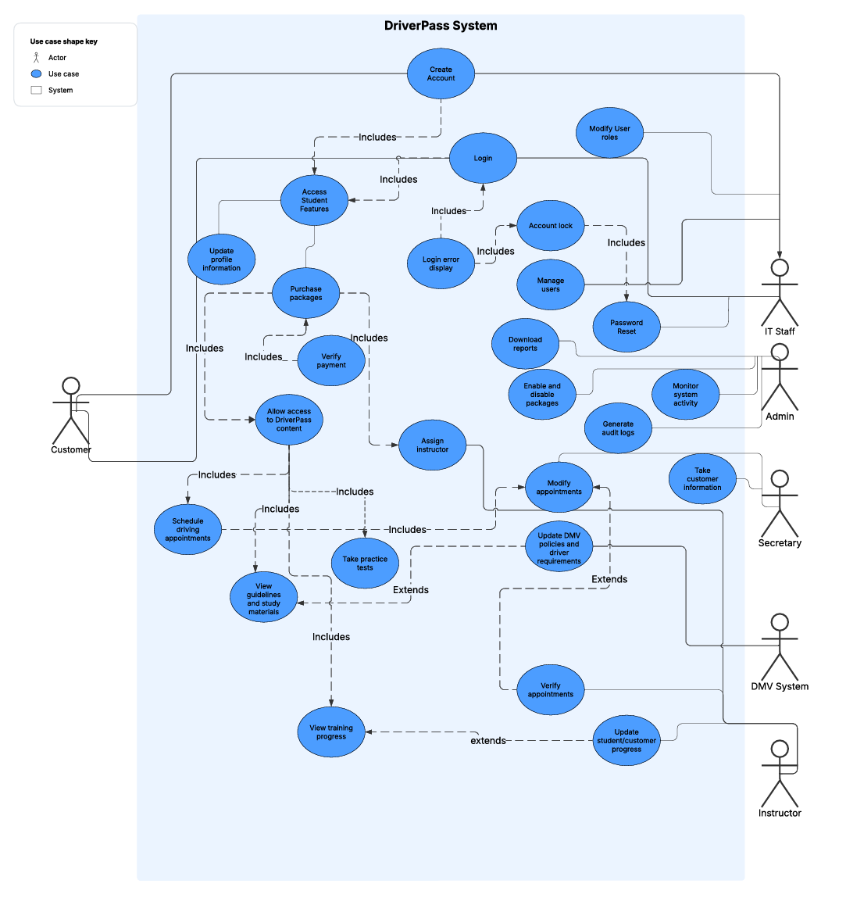
Use Case Diagram
Notes:
This diagram shows how the DriverPass system supports the needs of its users.
On the left, we see the student, who is the primary user. The system lets students sign up, log in, buy a course package, schedule driving lessons, and take practice tests. They can also track their training progress, update their profile, and view study materials. All of this helps them stay organized and feel confident as they prepare for their driving exams.
On the right side, we have other people who help keep the system running, like the secretary, instructor, administrator, and technical support staff. For example, the secretary can input customer information and help manage lesson schedules. Instructors can update student progress. Administrators can monitor system activity and generate reports. IT staff make sure that access is managed properly and that user accounts stay secure.
We also show a connection to the DMV, which is an outside system. This allows DriverPass to stay updated with the latest driving requirements, helping to keep everything accurate and compliant.
This design was built to meet the real needs of the DriverPass team. It makes sure every type of user can do what they need to do, and that all these parts work together smoothly.

Slide 4
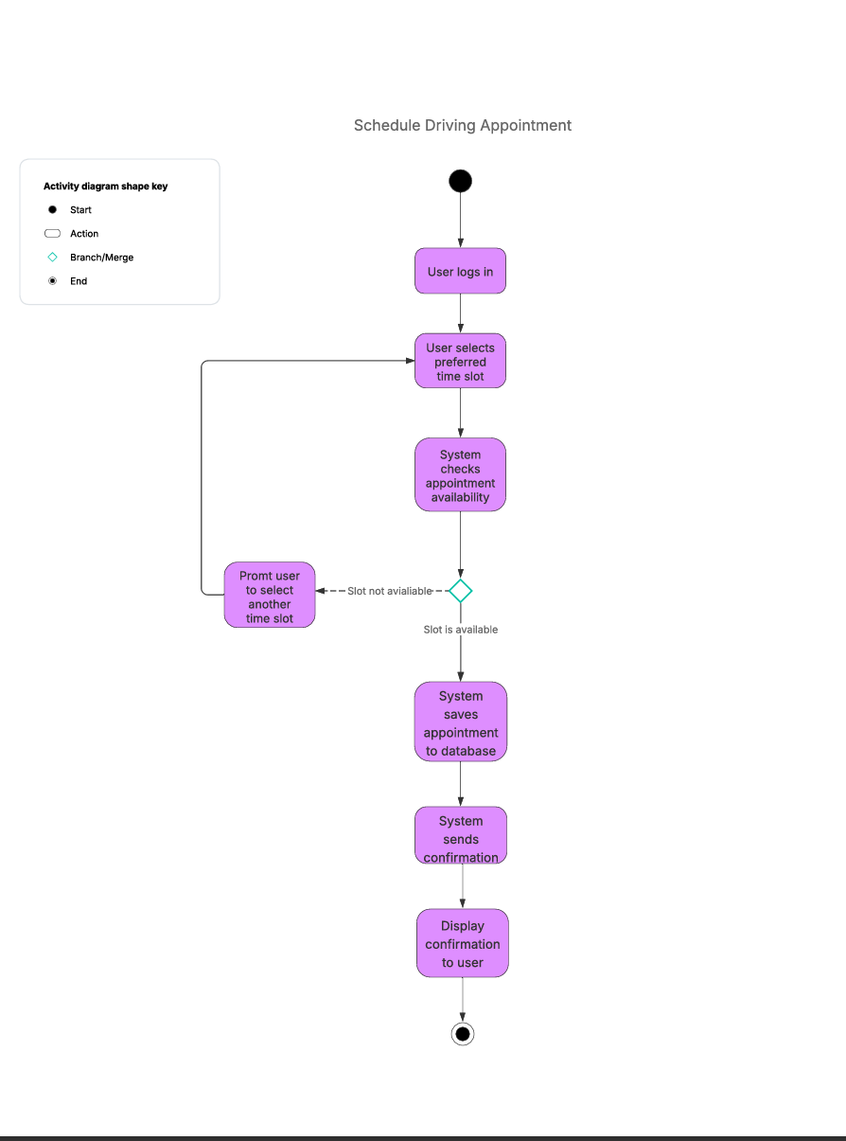
Activity Diagram
Notes:
This diagram walks through how a student schedules a driving appointment in the system.
The process begins when the student logs in. They choose a preferred time for their lesson. The system then checks to see if that time slot is available.
If the time is already booked, the system will prompt the student to choose a different time. If it’s available, the system saves the appointment and sends a confirmation message. The student then sees a confirmation on their screen, so they know everything went through.
This step-by-step flow was designed to make scheduling easy and clear for students, while helping DriverPass avoid double-booking. It ensures that every appointment is recorded and confirmed, giving both students and instructors a reliable experience.

Slide 5
Security
Passwords are kept private.
Information is protected online.
Only authorized users can access sensitive features.
Backup copies prevent data loss.
Extra protection blocks unwanted access.
Notes:
When designing DriverPass, we made security a top priority.
First, we make sure that all user passwords are kept private and protected. Any time someone enters personal information, like when registering or booking a lesson, the system protects it so no one else can see it.
We also make sure that only the right people have access to sensitive parts of the system. For example, a student can view their lessons, but only staff can see reports or make certain changes.
In case of any system problems, we’ve set up backup copies so nothing important is ever lost. And finally, the system includes extra safety features to block any unwanted access, helping to keep students, staff, and DriverPass running smoothly and safely.

Slide 6
System Limitations
Internet connection required.
Only supports one language (English).
Some features will be limited upon initial release.
One login session per user at a time.
Instructor schedules may fill up quickly.
Notes:
While the DriverPass system has been designed to be powerful and flexible, there are a few limitations to be aware of in the initial version.
At launch, the system will only be available in English. Supporting additional languages is something we may explore in the future. Also, while the system keeps up with DMV rules, it won’t automatically connect to DMV databases. Updates will need to be entered manually by an administrator.
Some advanced features, like adding or removing entire training packages through the system, won’t be available yet. Instead, administrators will be able to turn packages on or off as needed. Users can only be logged in on one device at a time. This helps reduce the risk of account misuse but may be a limitation for users switching between devices.
Finally, because instructors manage their own schedules, popular timeslots may book quickly, and students might need to be flexible when choosing appointment times.
These limitations were identified early so we could plan around them and focus on what matters most for students and staff in the first release.

